Slide 1
Travelling Wisely
With Robert Flanagan

Slide 2
Traveling with Haemophilia: Why it Matters
The importance of travel in our lives
Empowering individuals with haemophilia to explore the world

Slide 3
Within Ireland

Slide 4
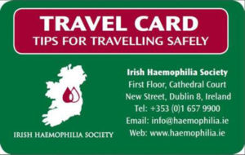
Travel Card

Slide 5
Treatment within Ireland
Bring enough factor to cover your trip and some extra just incase.
If you are planning a longer trip away from your home within Ireland, you should contact your HTC to organise treatment.

Slide 6
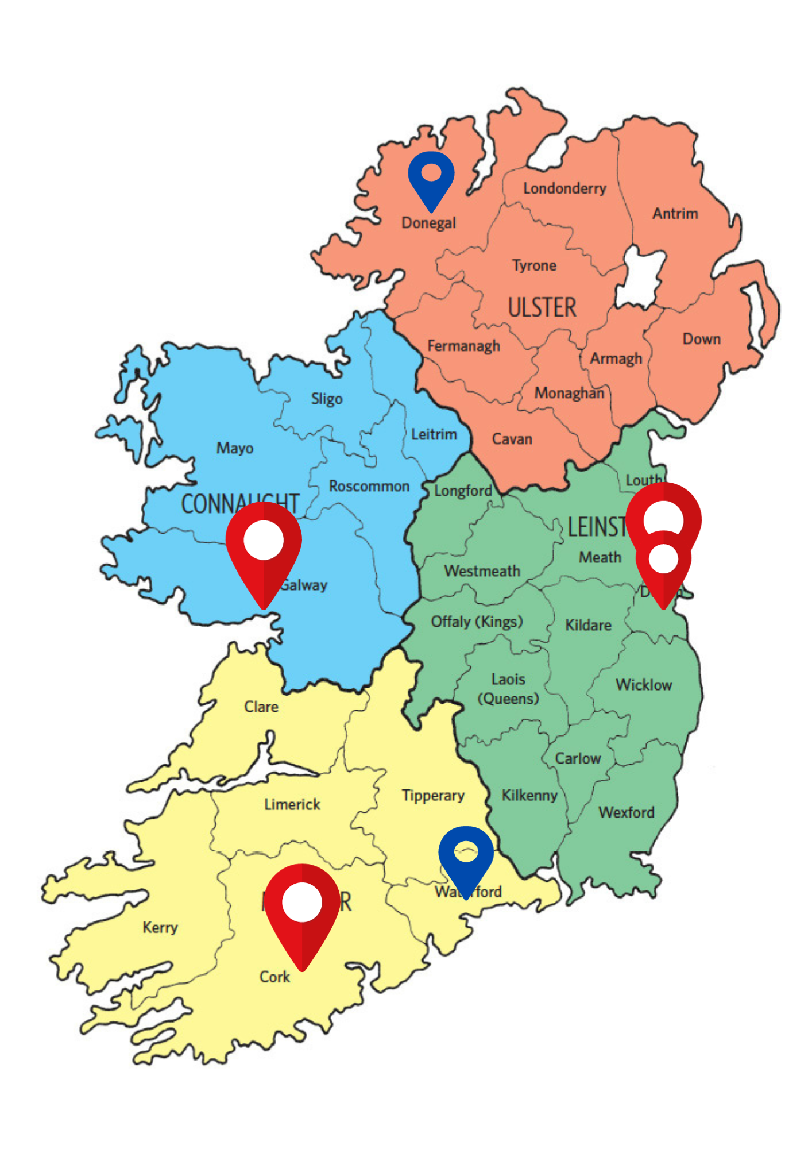
Holidaying in Ireland

Slide 7
Bleeding Disorder Alert Cards

Slide 8
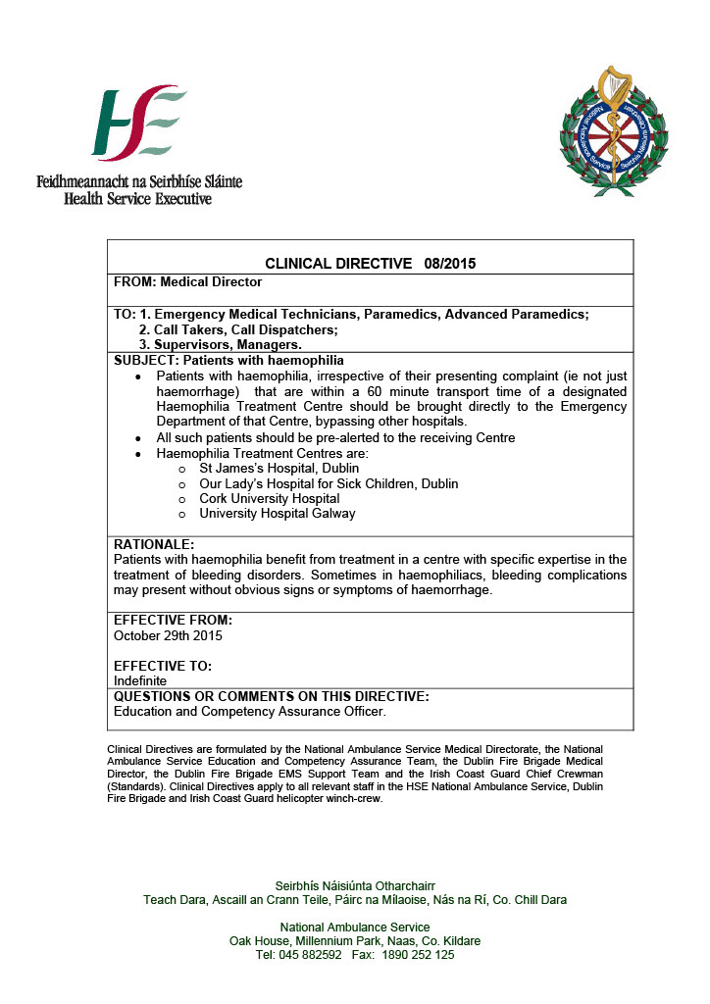
Ambulance Directive

Slide 9
Traveling Abroad

Slide 10
Speak to the IHS

Slide 11
What we do…
Researching local medical facilities
https://www.euhass.org/aspxpages/certcentres.aspx
https://wfh.org/find-local-support/

Slide 13
Contact your HTC
You will require a letter from HTC for airport security/customs.
The letter should be on headed paper and confirm that you are carrying treatment, needles, syringes etc, as well as relevant information on any metal implants (such as knees or hips) that may set off the security scanners.
The letter should not be more than six months old and should be updated as necessary.
This letter should be signed by a consultant doctor.

Slide 14
Find National Member Organization
https://wfh.org/find-local-support/find-a-wfh-nmo/

Slide 15
Travel Card

Slide 16
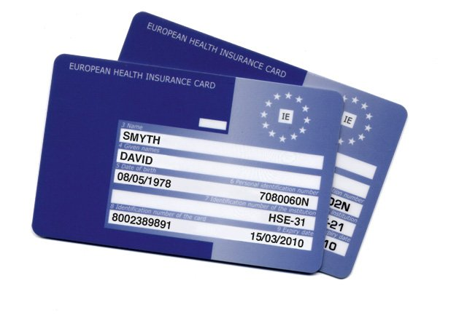
EHIC card
EHIC card (European Health Insurance Card).
This entitles you to necessary healthcare in the public system of any EU/EEA member state, or Switzerland if you become ill or injured while visiting another country. You can apply for the card online at
ehic.ie

Slide 17
Travel Insurance
No matter how fit and healthy you are, you can’t afford to travel overseas without travel insurance.
Check your travel insurance fine print to make sure that it will cover everything you will need, including your bleeding disorder.
To have cover for haemophilia you must declare it as a pre-existing condition. You may be required to pay an additional premium for this level of cover. If you do not declare your bleeding disorder, your insurance may be deemed void if medical care is required.
It is worth considering having all your documentation letters translated if you are travelling to non-English speaking countries

Slide 18
Cruises
Cruise cover should include medical expenses, as there is no Medicare when you’re on a cruise ship. This means you could be facing exorbitantly expensive international medical rates for something as simple as asking the doctor for some anti-nausea medication.
Hospitalisation costs on board can cost as much as $5,000 a day – and all consultations, treatments and medications are charged at private rates. Repatriation costs to get you home from an overseas port can run up to the tens of thousands.

Slide 19
Carrying Treatment
Always carry your own treatment (preferably in a small cooler bag), syringes, needles etc. with you as products vary in different countries.
A general rule when packing factor, you should bring your regular dose for the duration of your trip plus sufficient factor for at least one extra 100% rise.
It may be useful to pack one medication information insert and one box cover. In the event that you cannot treat yourself, or if there is a language barrier, this would be useful for the treating doctor.

Slide 20
Documents
Have copies all necessary travel documents
Tickets,
Passport,
Visa,
One form of ID,
Travel letters,
Insurance policy
Email them to yourself.

Slide 21
Department of Foreign Affairs
https://www.dfa.ie/travel/travel-advice/
https://www.dfa.ie/travel/visas/

Slide 22
Locate Your Nearest Pharmacy
My Maps
https://shorturl.at/mCHLN

Slide 23
Young Adults
America (J1 VISA)
Canada
Australia
Inter-railing (Europe)
Thailand
South America

Slide 24
Immunisations
Immunisations are necessary for some destinations, and you should check well ahead of time (approx. 8 weeks). Discuss this with your general practitioner (GP) and HTC.

Slide 25
Recap
Language barriers and communication
Contact your Treatment Centre
(Travel Letter and Treatment Plan)
Contact I.H.S.
Travel Insurance
I.H.S Travel Card
Plan your treatment storage.
Get details of the NMO.
Copy Documents
DFA
(VISA and General Information)
Research Your Destination.
Language barriers and communication

Slide 26
Safe Travels!

Slide 27
Question

